Slide 1
Network Security (CSE 350)
Assignment-2
Prof. B.N. Jain
Project 2 : AES Encryption/Decryption
Algorithm:
(1363+1362)%2=1
Submitted by:
Name Roll No
Vansh 2021363
V. Bharath Krishna 2021362

Slide 2
Brief Overview of Project
Programming Language: C++
Platform: MS Windows
AES Specifications for our implementation:
Key size used: 128 bits/16 bytes
Total number of rounds: 10
4 Plaintexts taken
Plaintexts size: 128 bits/16 bytes

Slide 3
Helper functions:
copy_data(): it copies data of 4x4 matrix of strings from matrix 1 to matrix 2
hex_string_to_binary(): This function creates a binary string from a hexadecimal
string.binary_to_hex(): This function produces a hexadecimal string from a binary
string.xor_operation(): XORs four binary strings together.Galois Field (GF) multiplication is implemented by GF_multiplication() and is utilized in the AES MixColumns procedure.
matrix_to_string(): Generates a string from a 4x4 matrix of hexadecimal strings.
string_to_matrix(): Generates a 4x4 matrix of hexadecimal strings from a string.

Slide 4
GF (Galois Field) Multiplication:
Galois Field (GF) multiplication is carried out on two hexadecimal strings that represent integers by this function, GF_multiplication. In the MixColumns stage of the AES (Advanced Encryption Standard) algorithm, which provides dispersion during the encryption process.
it multiplies two hexadecimal values by GF by first converting them to binary, then carrying out the multiplication in binary, decreasing the result within the Galois Field, and then transforming the result back to hexadecimal before returning it.

Slide 5
Methods used:
symmetric encryption technique in 128 bits of fixed-size blocks used to encrypt data by taking the input plain text of 128 bits/16 bytes. Original text in form of characters are converted into ASCII and this ASCII value is stored in the form of hexadecimals. 1 hexadecimal can represent 4 bit.
the encryption process uses 10 rounds of operations, where each round consist of four steps - SubBytes, ShiftRows, MixColumns, and AddRoundKey
Construction of Sbox and inverseSbox for substitution of bytes for encryption and decryption
Taking the plaintext as input and performing the AES Encryption algorithm where the following operations substitue_bytes(),shift_rows(), Mix_Column() add_round_key() finding returning the result matrix_to_string(ciphertext)
Similar to the AES Encryption process we decrypt the ciphertext using the AES Decryption algorithm using the inverse operations Inverse_Mix_Column(), inverse_shift_rows(), inverse_sub_bytes(), add_round_key() again returning the result matrix_to_string(ciphertext)
Finally checking the 1st Encryption and the 9th Decryption output both will give the same hexadecimal values and vice-versa for 4 pairs of (plain_text, cipher_text)

Slide 6
AES Encryption process
To store the intermediate and final encryption results, initialize the ciphertext and temporary matrices. The result in form of hexadecimals is converted to characters by converting the hexadecimal value into integer and finding the corresponding character to this integer ASCII value.
Create a matrix from the supplied plaintext by using the string_to_matrix function.Using the starting round key (sub_key[0]), perform the add_round_key operation with the initial round_key
For rounds 1 through 9, iteratively apply the substitue_bytes, shift_rows, Mix_Column, and add_round_key procedures.Following the initial encryption round, the intermediate ciphertext is kept in first_encryption.
Tenth and Final Round: Use the procedures shift_rows, add_round_key, and substitute_bytes for this round.We get final ciphertext.

Slide 7
AES Decryption process
Initialisation of the temp and plaintext matrices to hold the intermediate and final decryption results.
Create a matrix from the provided ciphertext by utilizing the string_to_matrix function.The First Round:Utilizing sub_key[10] as the last round key, do the add_round_key function.
Apply the procedures inverse_sub_bytes and inverse_shift_rows.Key Rounds 1 through 9:Iteratively apply the add_round_key, inverse_shift_rows, inverse_sub_bytes, and Inverse_Mix_Column procedures for rounds 9 to 1.
the Final Round(or Zeroth round) :Utilizing sub_key[0] as the first round key, apply the add_round_key function.Once received, the final plaintext is Obtained.

Slide 8
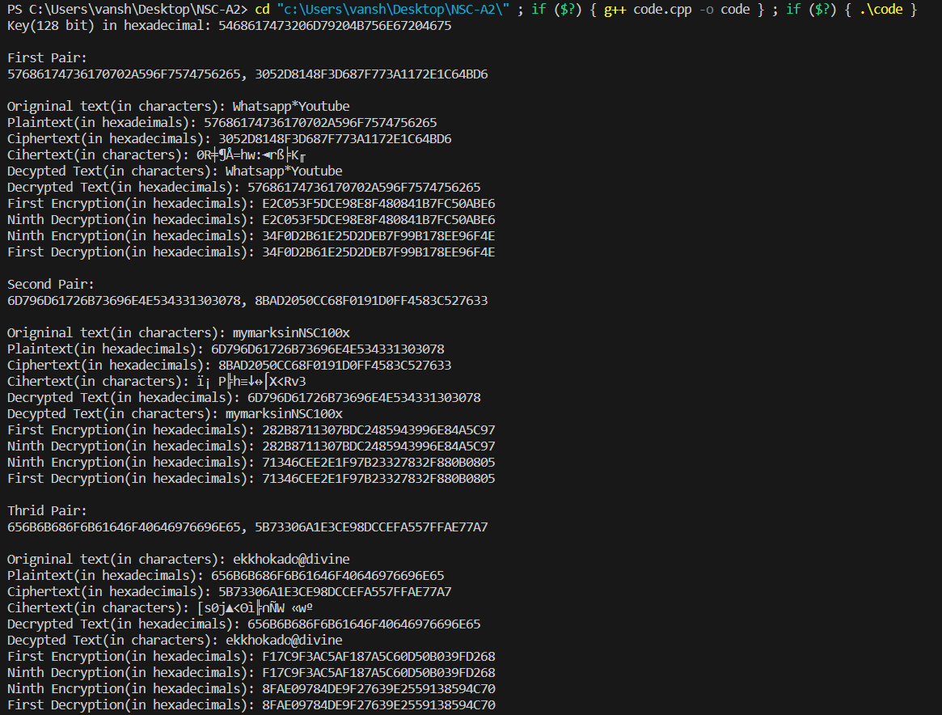
Sample input/output:

